Slide 1
Neural Networks for Trading
NNs success can be attributed to their power, versatility and ease of use
NNs are sophisticated modeling and prediction making techniques capable of modeling complex functions and data relationships
The ability to learn by examples is the key feature of NN that enables the user to model data and establish underlying relationships among data

Slide 2
NN for Trading
The NN user collects representative data and then invokes training algorithms which can automatically learn the structure of data
The user does need to have some heuristic knowledge on how to select and prepare data, how to select the appropriate NN, and how to interpret the results

Slide 3
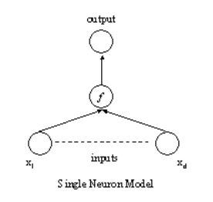
NN – the Basic Mathematical Model
The inputs x send signals to the neuron at which point a weighted sum of the signals is calculated and further transformed using a mathematical function

Slide 4
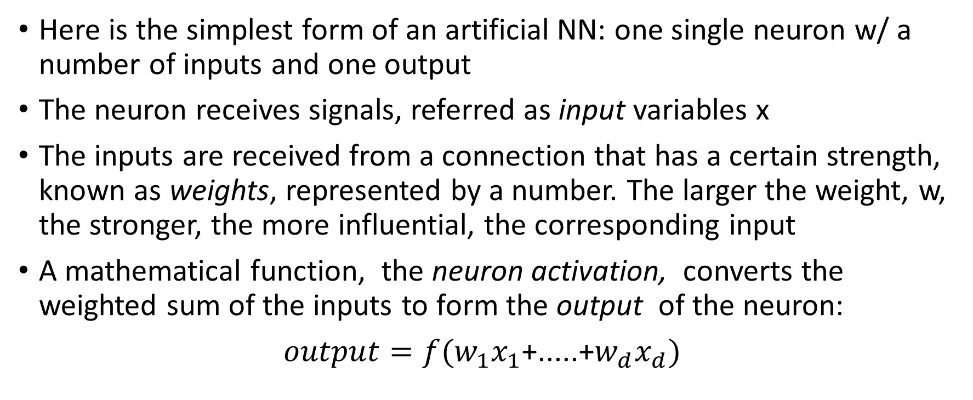
NN – the Basic Mathematical Model
Here is the simplest form of an artificial NN: one single neuron w/ a number of inputs and one output
The neuron receives signals, referred as input variables x
The inputs are received from a connection that has a certain strength, known as weights, represented by a number. The larger the weight, w, the stronger, the more influential, the corresponding input
A mathematical function, the neuron activation, converts the weighted sum of the inputs to form the output of the neuron:
$output=f(w_{1}x_{1}$+.....+$w_{d}x_{d})$

Slide 5
NN – architecture
One single neuron is not enough – many interconnected neurons are needed to achieve any specific goal. Hence the concept of NN architecture
A simple network has a feedforward structure: signals flow from inputs, forward through any hidden units and eventually reaching the output units
A typical feedforward network has neurons arranged in a distinct layered topology
Multilayer Perceptrons (MLP) is perhaps the most popular network architecture

Slide 6
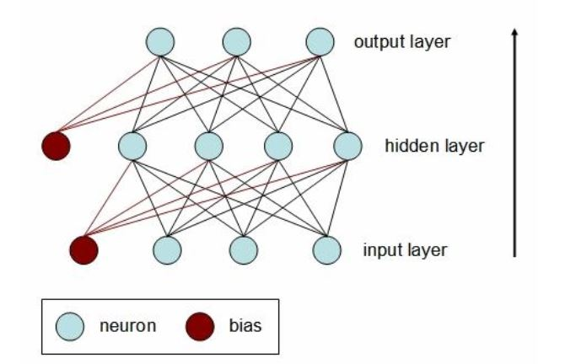
NN – architecture....
The Multilayer Perceptron (MLP) is perhaps the most popular network architecture

Slide 7
NN – activation function
A multilayer perceptron (MLP) is a feedforward NN architecture w/ unidirectional full connections between successive layers
In addition, the neurons of a network have activation functions that transform the incoming signals from the previous layer neurons using a mathematical function
Input neurons have for activation function the identity – the input signals are not transformed at all. They are combined in a weighted sum (weighted by the input-hidden layer weights) and passed on to the neurons in the layer above (usually called the hidden layer)
Same for the output neuron activation function – no transformation

Slide 8
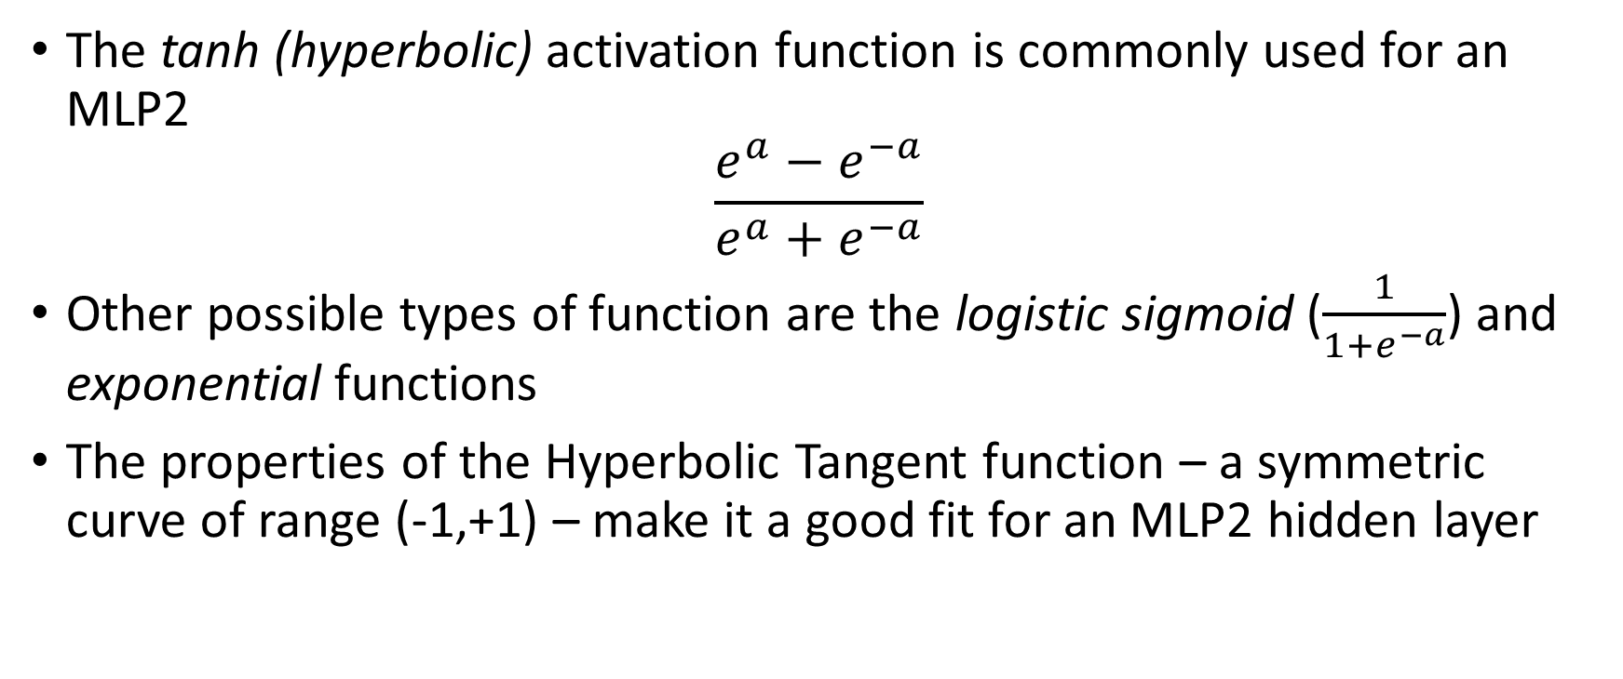
NN – MLP2 activation function
The tanh (hyperbolic) activation function is commonly used for an MLP2
$$\frac{e^{a}−e^{−a}}{e^{a}+e^{−a}}$$
Other possible types of function are the logistic sigmoid ($\frac{1}{1+e^{−a}}$) and exponential functions
The properties of the Hyperbolic Tangent function – a symmetric curve of range (-1,+1) – make it a good fit for an MLP2 hidden layer

Slide 9
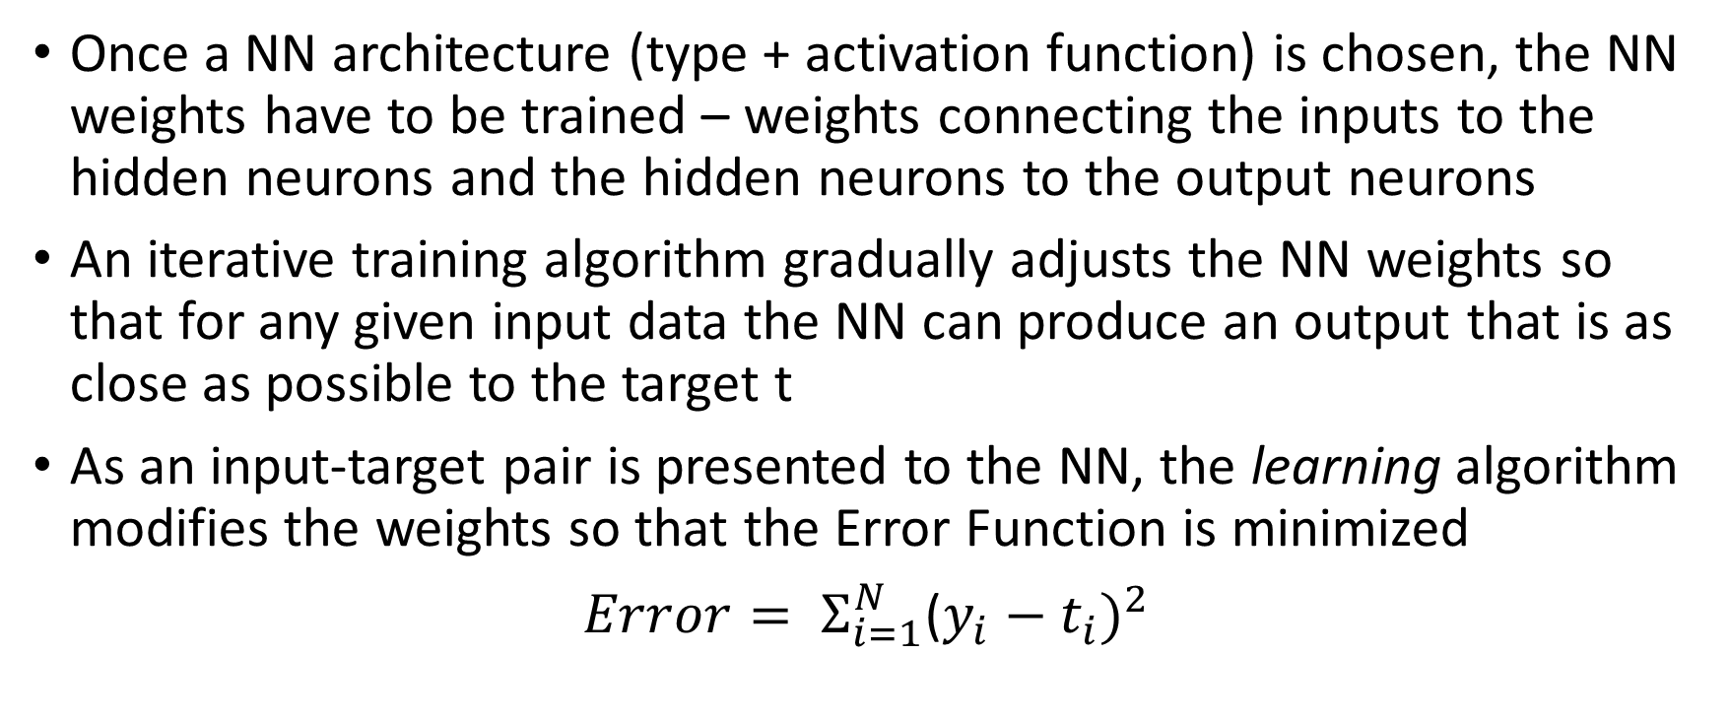
NN – training
Once a NN architecture (type + activation function) is chosen, the NN weights have to be trained – weights connecting the inputs to the hidden neurons and the hidden neurons to the output neurons
An iterative training algorithm gradually adjusts the NN weights so that for any given input data the NN can produce an output that is as close as possible to the target t
As an input-target pair is presented to the NN, the learning algorithm modifies the weights so that the Error Function is minimized
$Error= Σ_{i=1}^{N}$($y_{i}−t_{i})^{2}$

Slide 10
NN – more details
Two other topics of importance that we will not cover
NN Generalization (also called Pruning)
Pre and Post Processing of Data
Because of the Saturation Effect, we need to scale the inputs to a (-1,+1) range
There is also a need to standardize Inputs and Targets

Slide 11
Bibliography
Pre-Trade Transaction Cost Estimation Using a Dealer Behaviour Model – Morgan Stanley QSI January 30, 2014
Algorithmic and High Frequency Trading by Cartea, Jiamungal & Penalva – Cambridge University Press
Behavioural Investing by James Montier – Wiley
The Value of Millisecond Expiry Options in Spot Foreign Exchange Markets by John Stevenson, May 2016
The Sterling “Flash Event” of October 7 2016, Markets Committe, Bank For International Settlements

Slide 12
Bibliography....
Statistica Help Online -- http://documentation.statsoft.com/STATISTICAHelp.aspx?path=SANN/Overview/SANNNeuralNetworksAnOverview

Slide 13
NN Bibliography
Bishop, C. (1995). Neural Networks for Pattern Recognition. Oxford: University Press.
Carling, A. (1992). Introducing Neural Networks. Wilmslow, UK: Sigma Press.
Fausett, L. (1994). Fundamentals of Neural Networks. New York: Prentice Hall.
Haykin, S. (1994). Neural Networks: A Comprehensive Foundation. New York: Macmillan Publishing.
Kohonen, T. (1982). Self-organized formation of topologically correct feature maps.Biological Cybernetics, 43:59-69.
Patterson, D. (1996). Artificial Neural Networks. Singapore: Prentice Hall.
Ripley, B.D. (1996). Pattern Recognition and Neural Networks. Cambridge University Press.
Rumelhart, D.E., and J.L. McClelland (1986), Parallel Distributed Processing, Volume 1. The MIT Press. Foundations.
Tryon, R. C. (1939). Cluster analysis. New York: McGraw-Hill.

